Slide 1
27
SIP
Endpoint
API Endpoints
Experimental Containerized SIP Softphone
G.722 · PCMU · PCMA
v1.1
Full-featured SIP softphone built for
engineers and cloud deployments
Containerized
No audio hardware required.
Fully headless-capable via REST API
Fully functional Web UI
Codecs
Docker / Podman
Deployment
pcap + WAV per call
Capture
For Developers & Engineers

Slide 2
Problem & Use Cases
The Gap
Potential Use Cases
Traditional SIP softphones require audio hardware
TEST
SIP Testing
Automate call flows with REST API - no physical hardware needed
Difficult to automate — no headless / API-driven control
No built-in packet capture for SIP/RTP analysis
PCAP
Network Analysis
Capture SIP + RTP per call, open in Wireshark
Difficult to containerise and deploy to cloud
Testing SIP systems usually needs a physical phone
CLOUD
Cloud Deployment
Runs headless on any cloud VM, no audio hardware
CI/CD
CI/CD Integration
Trigger calls, play audio, verify via API in pipelines
PHONE
Softphone
Full-featured web UI for engineers/home lab hobbyists

Slide 3
Architecture Overview
Docker / Podman Container
server.js
sipManager.js
captureManager.js
Express HTTP
REST API + WebSocket
JsSIP UA
SIP over WebSocket
pcap writer
Pure Node.js
audioDecoder.js
callHistory.js
RtpBridge
G.722/PCMU decode
Inbound WAV rec.
Persistent history
JSON + CSV
dgram UDP sockets
G.722 inject
SIP/WS ←→
HTTP/WS ←→
RTP/UDP ←→
.pcap
SIP PBX (Asterisk / FreePBX / Kamailio)
Browser / REST Client
Wireshark

Slide 4
SIP & Media Stack
SIP Signalling
RTP Media
Library:
JsSIP 3.10 - battle-tested WebSocket SIP stack
Engine:
Node.js dgram UDP - no WebRTC, no audio hardware
Transport:
WebSocket (ws:// or wss://) to PBX port 8088
Codecs:
G.722 (preferred) · PCMU/G.711μ · PCMA/G.711A
Node.js fix:
global.WebSocket + RTCPeerConnection stubs
G.722:
16kHz wideband ADPCM - RTP clock 8000 per RFC 3551
ICE bypass:
onicecandidate(null) fired immediately in setLocalDescription
Framing:
20ms frames, 160 bytes @ G.722 (64kbps)
SDP:
Hand-built offer/answer - G.722 + PCMU + PCMA + tel-event
Playback:
Pre-encoded G.722 file → injected into stream SSRC
Hold:
Raw re-INVITE via transport._ws - avoids getSenders()
Recording:
G.722 decoder → 16kHz PCM → WAV file per call
Transfer:
REFER (blind) and REFER+Replaces (attended)
Capture:
libpcap-format .pcap, pure Node.js, no tcpdump
DTMF:
RFC 2833 telephone-event via session.sendDTMF()
Cloud NAT:
No audio HW needed - works on any cloud VM

Slide 5
Feature Set
Call Control
Transfer
WAV Playback
Outbound INVITE with custom SDP
Blind transfer (REFER)
Upload any WAV - auto G.722 convert
Inbound answer / reject
Attended transfer (REFER+Replaces)
Inject into live RTP stream
Hold & resume via re-INVITE
3-way conference bridge
Syncs to stream SSRC/seq/ts
DTMF RFC 2833
Drop conference leg only
Play · Stop via API
Packet Capture
History & Logging
REST API
Per-call .pcap (libpcap format)
Persistent call history (JSON)
24 endpoints - fully documented
Wireshark-compatible
CSV export
OpenAPI 3.1 spec included
Inbound RTP decoded to .wav
Real-time system log
WebSocket real-time events
Download via UI or API
Expandable log panel in UI
Headless / CI/CD ready

Slide 6
REST API & WebSocket Events
REST Endpoints (27 total · OpenAPI 3.1 spec included)
Registration
GET /api/status · POST /api/register · POST /api/unregister
Calls
POST /api/call · /api/answer · /api/hangup · /api/reject · /api/dtmf
Hold
POST /api/hold · POST /api/resume
Transfer
POST /api/transfer/blind · POST /api/transfer/attended
Conference
POST /api/conference · POST /api/conference/end
WAV Playback
GET /api/wavfiles · POST /api/wavfiles/upload · POST /api/play · POST /api/play/stop
Captures
GET /api/captures · DELETE /api/captures/:filename
History/Logs
GET /api/history · GET /api/history/export · DELETE /api/history · GET /api/log/export · GET /api/stats · POST /api/record/start · POST /api/record/stop
WebSocket Events (ws://host:3000)
state
registered
unregistered
registrationFailed
incomingCall
callConnected
callEnded
callFailed
callHeld

Slide 7
Packet Capture & Audio Recording
.pcap - SIP + RTP Capture
.wav - Inbound Audio Recording
Pure Node.js - no tcpdump, no raw socket permissions
Decodes inbound RTP payload in real time
libpcap binary format (magic 0xa1b2c3d4)
G.722 → 16kHz 16-bit PCM (sub-band ADPCM decoder)
Link type 228 - Raw IPv4 (no fake Ethernet headers)
PCMU → 8kHz PCM via μ-law table
SIP messages captured via JsSIP transport._ws hook
PCMA → 8kHz PCM via A-law table
RTP packets written from dgram socket message events
Writes PCM samples directly to file during call
One file per call, named with timestamp + call ID prefix
WAV header written on call end (knows sample count)
Download via UI (↓ PCAP button) or GET /api/captures
One .wav per call, linked to matching .pcap in UI
Open in Wireshark → Telephony → VoIP Calls
Download via ↓ WAV button or /captures/audio_*.wav

Slide 8
Deployment
Docker
Podman (Fedora)
Cloud / Headless
Standard docker-compose.yml included
Native on Fedora - no install needed
No audio hardware required
Multi-stage Alpine build
podman-compose up -d --build
No /dev/snd, ALSA, or PulseAudio
tini as PID 1
network_mode: host recommended
Media = raw UDP network I/O only
ffmpeg for WAV conversion
(avoids SIP/RTP NAT issues)
Works on any VM with Docker/Podman
Volume: /captures for pcap + WAV
privileged: true for pcap access
NAT note: advertise public IP in SDP
security_opt: label=disable
Firewall: open UDP 10000-20000 (RTP)
docker-compose up -d --build
systemd unit via podman generate
Port 3000 for UI + API access
Requirements: Docker / Podman · ffmpeg (in container) · Network access to SIP PBX · UDP 10000-20000 open · Port 3000 for UI

Slide 9
Web UI
Registration Panel
Softphone Panel
Right Panel (Tabs)
SIP server, port, WS port
Live call display card (blue gradient)
Captures: ↓ PCAP · ↓ WAV per call
Transport: UDP / TLS
DTMF dialpad (12 keys)
WAV Files: upload · play · delete
Username, password, display name
Hold / Resume controls
History: direction, target, duration
Locks form when registered
Blind + attended transfer
status, timestamp, ↓ pcap link
Populates from API state on reload
3-way conference with drop
CSV export · Clear history
Full API endpoint reference
WAV file selector + playback
Collapsible log panel + export
Theme: Clarity — DM Sans + DM Mono · White card surfaces · Blue/Green/Amber status system · Collapsible log with unread count

Slide 10
Technology Stack
Layer
Technology
Notes
Runtime
Node.js 20
Alpine-based container, tini PID1
SIP Stack
JsSIP 3.10
WebSocket SIP UA with custom stubs for Node.js
Web Server
Express 4
REST API + static frontend + WebSocket hub
WebSocket
ws 8
Server-side WS for SIP transport and UI events
Media
Node.js dgram
Raw UDP RTP - no WebRTC, no audio hardware
Audio Codec
G.722 ADPCM
ffmpeg encode at upload · custom decoder for recording
Capture
libpcap format
Hand-written pcap writer in pure JavaScript
File Upload
multer 1.4
WAV upload → ffmpeg → raw G.722 bitstream
Audio Convert
ffmpeg
WAV → 16kHz mono G.722 at upload time in container
History
JSON file
Persistent to /captures volume, CSV export
Frontend
Vanilla HTML/JS
Single-file, no framework, WebSocket-driven
API Spec
OpenAPI 3.1
Full spec included — Swagger / Postman / Redocly

Slide 11
Key Design Decisions
JsSIP in Node.js - Why & How
No tcpdump -Pure Node.js pcap
JsSIP is browser-first. Making it work in Node required: injecting global.WebSocket, stubbing RTCPeerConnection with immediate ICE signalling (onicecandidate null), and bypassing renegotiate() entirely for hold/resume by writing raw SIP directly to transport._ws.
Cloud and rootless Podman environments restrict raw socket access. The captureManager writes valid libpcap files directly using Buffer operations — same format as Wireshark, zero system dependencies.
G.722 over PCMU - Wideband by Default
Stream Hijacking for WAV Playback
SDP advertises G.722 (PT 9) as the preferred codec. WAV files are converted to raw G.722 at upload time using ffmpeg so playback is zero-cost at runtime — just send bytes. A custom ADPCM decoder handles inbound recording.
During playback, the RtpBridge copies the live stream's SSRC and sequence number before taking over. Incoming RTP is suppressed. This avoids jitter buffer confusion at the far end caused by two SSRCs on the same flow.

Slide 12
Quick Reference
SIP
Endpoint
Web UI
http://localhost:3000
Containerized SIP Softphone
API Status
GET /api/status
What we built:
Full-featured SIP softphone — no audio HW
24-endpoint REST API + WebSocket events
G.722 wideband audio, WAV injection
Per-call pcap + decoded audio recording
Docker/Podman, cloud-ready, headless
OpenAPI 3.1 spec included
OpenAPI Spec
openapi.json
Captures
/captures/ volume
WAV Files
/wavfiles/ volume
History
/captures/call_history.json
Built with Node.js · JsSIP · Express · pptxgenjs

Slide 13
What's New in v1.1
v1.0 to v1.1 | 15 new features
Audio & Media
Call Handling
UI & Reliability
Live audio relay to browser
ws://host:3000/audio + Web Audio API
On-demand call recording
POST /api/record/start|stop
Live RTP stats panel
Codec, jitter, loss%, RX/TX kbps
Browser notifications + ringtone
On incoming call when tab unfocused
Missed call detection
History: missed / cancelled status
CANCEL support
Pre-answer hangup sends CANCEL
Remote hold detection
a=sendonly re-INVITE shown in UI
Full SIP capture in pcap
INVITE/100/180/200/ACK/BYE
Dark / light mode
Toggle persisted to localStorage
Mobile responsive layout
Breakpoints at 1100px and 768px
OPTIONS keepalive
30s ping, auto re-register on fail
Graceful WS reconnection
Call cleanup + auto-reconnect

Slide 14
APPENDIX
UI Screenshots
Web UI walkthrough — Clarity theme softphone interface

Slide 15
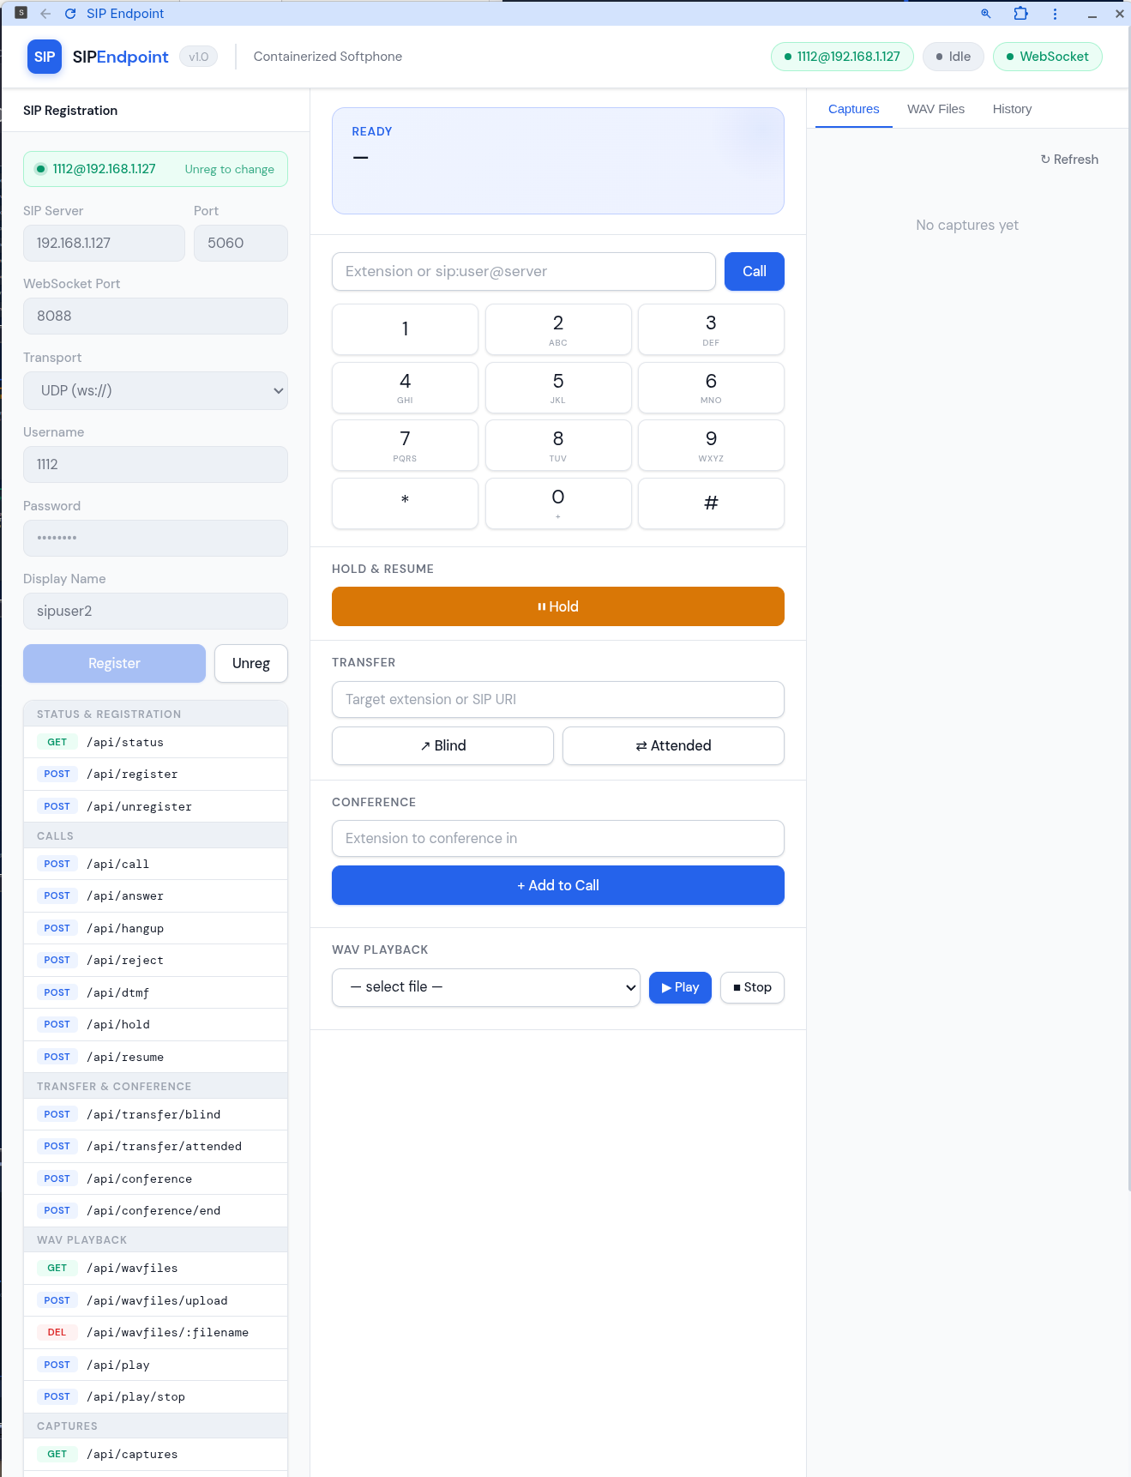
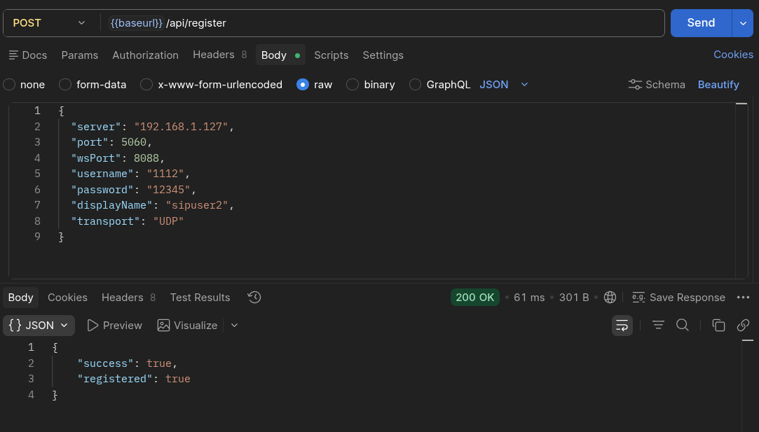
Registration & Call Panel
APPENDIX
SIP registration form · locked when registered · call display card · G.722 status

Slide 16
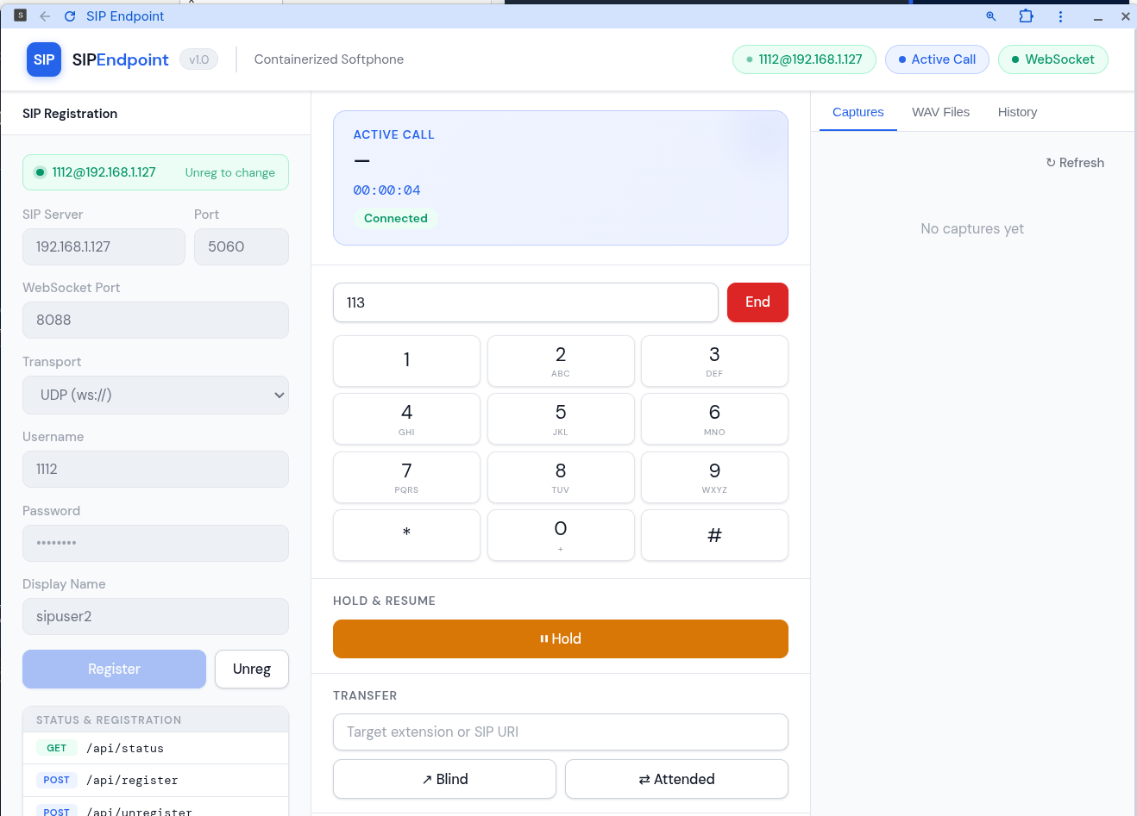
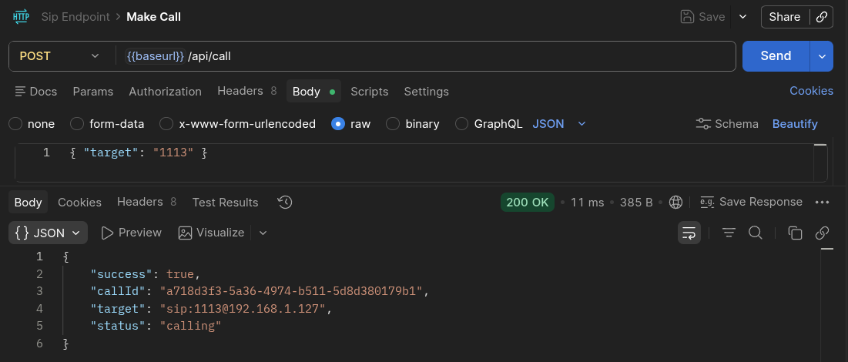
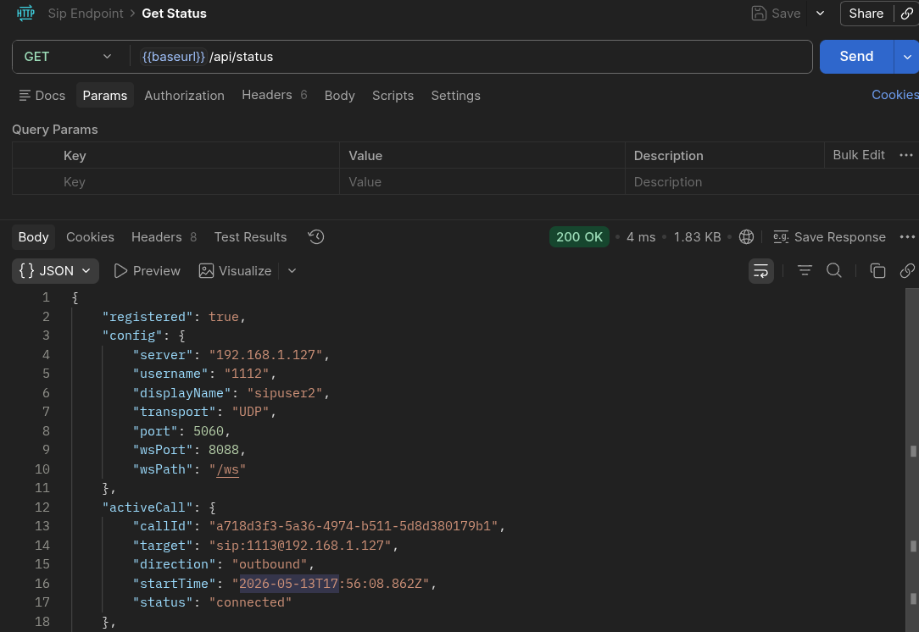
Dialpad · Transfer · Conference
APPENDIX
DTMF dialpad · hold/resume · blind/attended transfer · 3-way conference controls

Slide 17
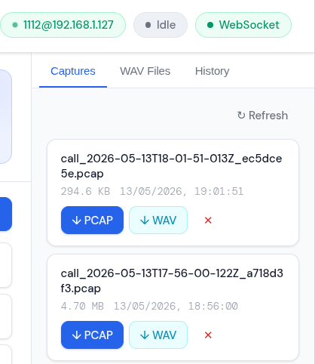
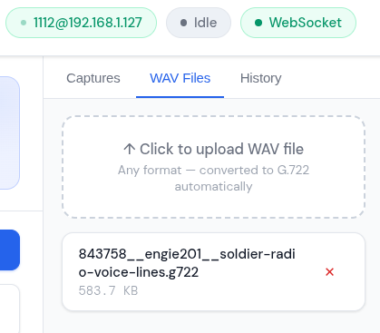
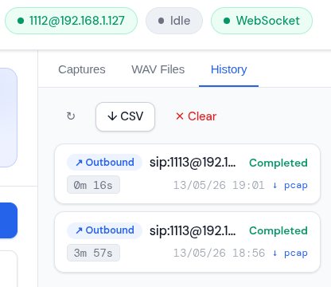
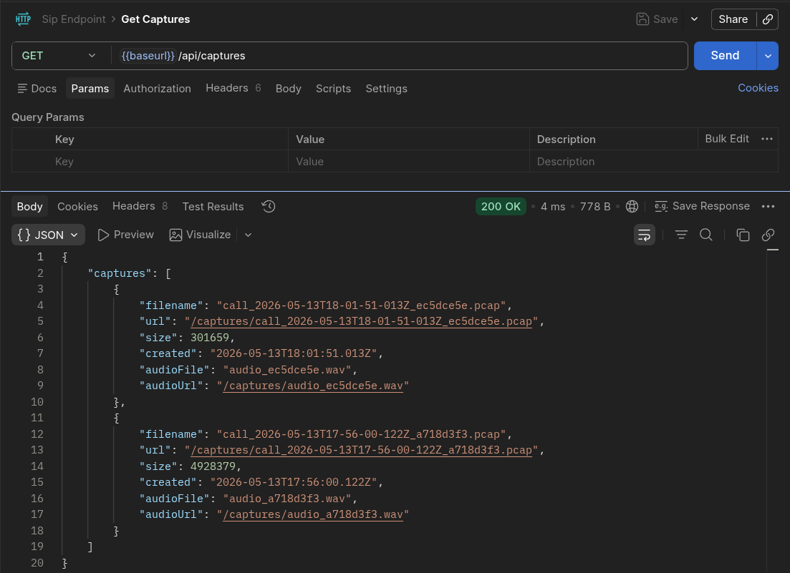
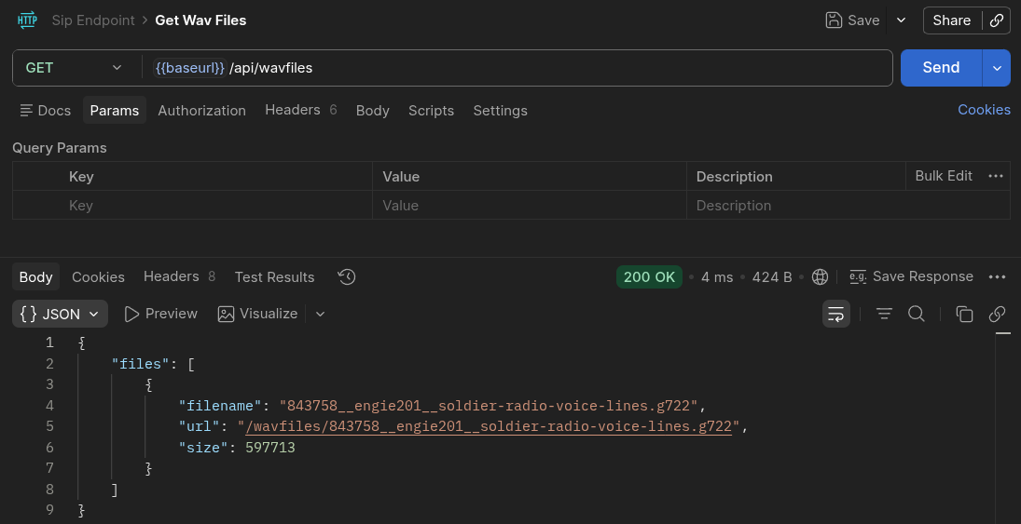
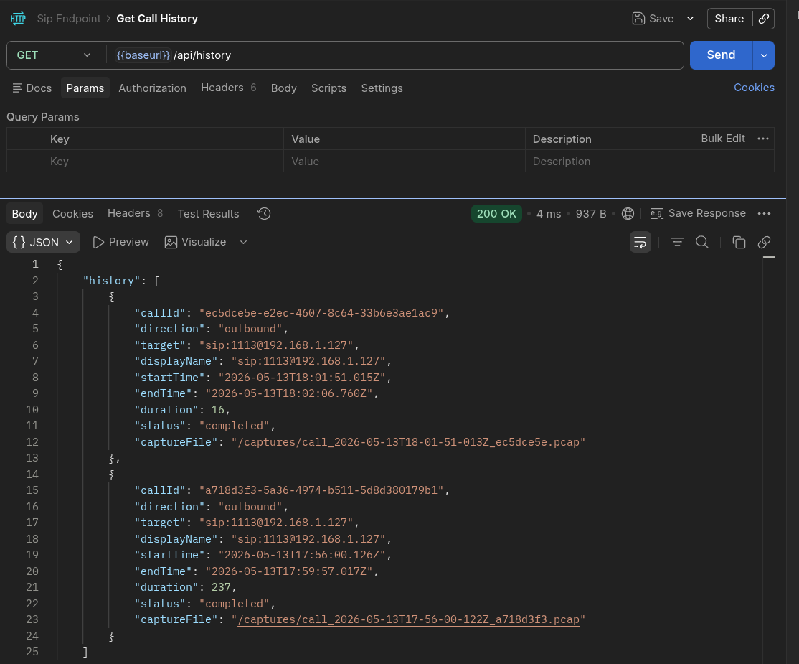
Captures · WAV Files · History
APPENDIX
Per-call pcap + WAV download · WAV file upload · call history with duration and status

Slide 18
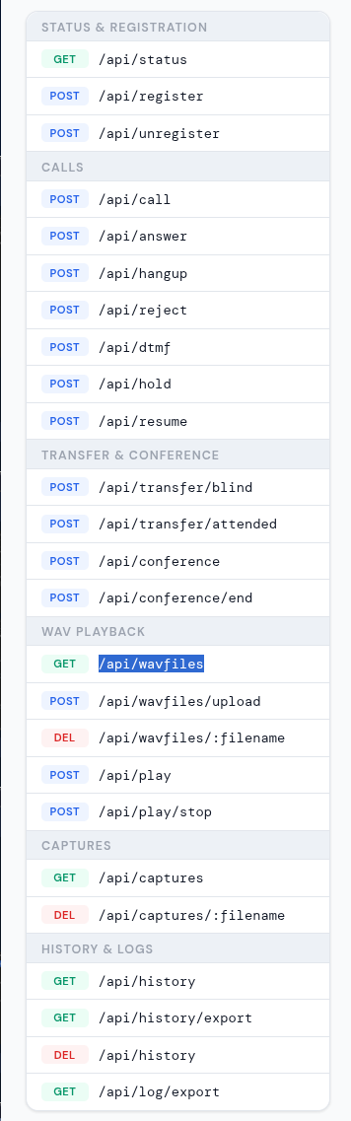
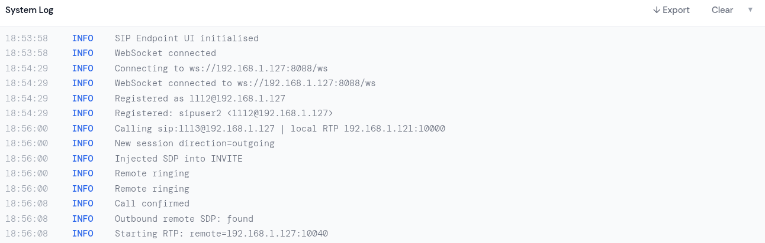
System Log · API Reference
APPENDIX
Expandable system log with export · full REST API endpoint reference card

